Slide 1
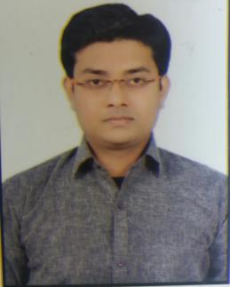
Rahul Lall
Main Focus
Primary Skills:
J2EE,Spring Framework
Automation(UiPath)
Secondary Skills:
PREDIX, Python, Angular-JS, HTML
Java-script and R Scripting
Industries worked for:
Energy and Utilities
Rahul Lall
+91-7785065259
rahul.lall@capgemini.com
Profile Summary
A Brief Summary of Experience
Digital seer project - Optimization of energy and monitoring of the application to avoid certain sudden breakdown. Responsibilities:
Forming micro-services using java and spring boot.
Development of data analytics using Python and deployment on PREDIX.
Automated following use cases (Tool used - UiPath):
Automating the task of getting details of the list of employee and sending the data to authorized person : It used to involve manual excel reading and then finding data from Employee directory. This task was automated to get details by reading the names from excel sheet and writing back the data required into excel and mailing it.
Scrapping data from the website and performing operations: Automating the task of searching for the products by browsing through the pages of the website and collecting all the user required data and perform operation like sorting and filtering according to user requirements and providing them a consolidated list of the items they query for.
Reading the PDF and extracting data: Automated the task of reading the pdf invoice of the cab and finally making consolidated list that contained the travel expense of a particular person of a particular month into an excel which would automate the part of travel reimbursement claims.
Worked on the development of micro-service using J2EE and Spring as primary technology with around 11 months experience.
Capgemini Automation Certification which included completion of scripting languages(Python and R Scripting) and an automation tool(UiPath).
UiPath Tool Certification.
Worked on data analytics using Python.
Training on PREDIX and Automation with UiPath tool.
Well organized; Strong work ethics; short learning curve and desire to achieve team objectives and goals; team player
Requirements and Analysis :
Understanding the requirements and analyzing for the real time problem scenarios as well as getting it resolved and act as a functional/technical resource.

